Slide 1

String Handling
BY
SANA MATEEN

Slide 2
String
String is probably the most commonly used class in java library.
String class is encapsulated under java.lang package. In java, every string that you create is actually an object of type String.
One important thing to notice about string object is that string objects are immutable that means once a string object is created it cannot be altered.
What is an Immutable object?
An object whose state cannot be changed after it is created is known as an Immutable object.
String, Integer, Byte, Short, Float, Double and all other wrapper classes objects are immutable.

Slide 3
Creating a String object
String can be created in number of ways, here are a few ways of creating string object.
1) Using a String literal
String literal is a simple string enclosed in double quotes " ". A string literal is treated as a String object.
String str1 = "Hello";
2) Using another String object
String str2 = new String(str1);
3)Using new Keyword
String str3 = new String("Java");
4) Using + operator (Concatenation)
String str4 = str1 + str2; or, String str5 = "hello"+"Java";
String objects are stored in a special memory area known as string constant pool inside the heap memory.

Slide 4
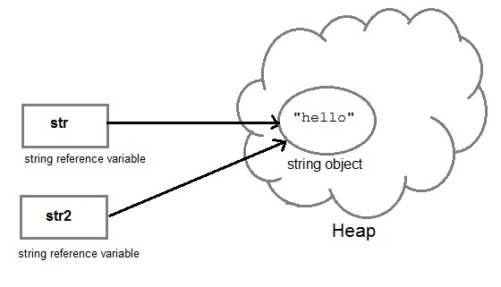
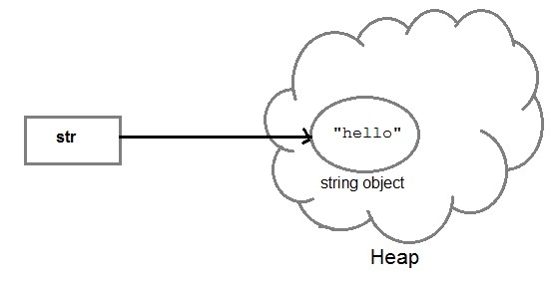
String object and How they are stored
When we create a new string object using string literal, that string literal is added to the string pool, if it is not present there already.
String str= "Hello";
String str2=str;

Slide 5
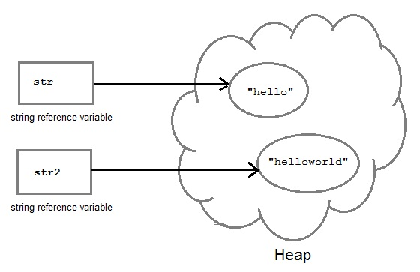
But if we change the new string, its reference gets modified.
str2=str2.concat("world");

Slide 6
Concatenating String
There are 2 methods to concatenate two or more string.
Using concat() method
Using + operator 1) Using concat() method
String s = "Hello";
String str = "Java";
String str2 = s.concat(str);
String str1 = "Hello".concat("Java");
2) Using + operator
String str = "Rahul";
String str1 = "Dravid";
String str2 = str + str1;
String st = "Rahul"+"Dravid";

Slide 7
String Comparison
String comparison can be done in 3 ways.
Using equals() method
Using == operator
By CompareTo() method
Using equals() method
equals() method compares two strings for equality. Its general syntax is,
boolean equals (Object str)
It compares the content of the strings. It will return true if string matches, else returns false.
String s = "Hell";
String s1 = "Hello";
String s2 = "Hello";
s1.equals(s2); //true s.equals(s1) ; //false
Using == operator
== operator compares two object references to check whether they refer to same instance. This also, will return true on successful match.
String s1 = "Java";
String s2 = "Java";
String s3 = new string ("Java");
test(s1 == s2) //true test(s1 == s3)

Slide 8
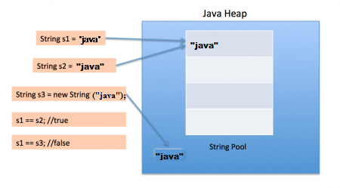
By compareTo() method
compareTo() method compares values and returns an int which tells if the string compared is
less than, equal to or greater than the other string. It compares the String based on natural
Ordering i.e alphabetically.
Its general syntax is,
int compareTo(String str)
String s1 = "Abhi";
String s2 = "Viraaj";
String s3 = "Abhi";
s1.compareTo(S2); //return -1 because s1 < s2
s1.compareTo(S3); //return 0 because s1 == s3
s2.compareTo(s1); //return 1 because s2 > s1

Slide 9
String class functions
String class function
The following methods are some of the most commonly used methods of String class.
charAt()
charAt() function returns the character located at the specified index.
String str = "tonight";
System.out.println(str.charAt(2)); Output : u
Note: Index of a String starts from 0, hence str.charAt(2) means third character of the String str.
equalsIgnoreCase()
equalsIgnoreCase() determines the equality of two Strings, ignoring thier case (upper or lower case doesn't matters with this fuction ).
String str = "java";
System.out.println(str.equalsIgnoreCase("JAVA")); Output : true
length()
length() function returns the number of characters in a String.
String str = "Count me";
System.out.println(str.length()); Output : 8

Slide 10
replace() method replaces occurances of character with a specified new character.
String str = "Change me"; System.out.println(str.replace('m','M')); Output : Change Me
toLowerCase() method returns string with all uppercase characters converted to lowercase.
String str = "ABCDEF"; System.out.println(str.toLowerCase()); Output : abcdef
toUpperCase()
This method returns string with all lowercase character changed to uppercase.
String str = "abcdef";
System.out.println(str.toUpperCase()); Output : ABCDEF trim()
This method returns a string from which any leading and trailing whitespaces has been removed.
String str = " hello "; System.out.println(str.trim()); Output : hello
Note: If the whitespaces are between the string ,for example: String s1 = "study tonight"; then System.out.println(s1.trim()); will output "study tonight".
trim() method removes only the leading and trailing whitespaces.

Slide 11
indexOf() function returns the index of first occurrence of a substring or a character. indexOf() method has four forms:
int indexOf(String str) It returns the index within this string of the first occurrence of the specified substring.
int indexOf(int ch, int fromIndex) It returns the index within this string of the first occurrence of the specified character, starting the search at the specified index.
int indexOf(int ch) It returns the index within this string of the first occurrence of the specified character.
int indexOf(String str, int fromIndex) It returns the index within this string of the first occurrence of the specified substring, starting at the specified index.
Example:
public class StudyTonight {
public static void main(String[] args) {
String str="Tonight";
System.out.println(str.indexOf('u')); //3rd form
System.out.println(str.indexOf('t', 3)); //2nd form
String subString="Ton";
System.out.println(str.indexOf(subString)); //1st form
System.out.println(str.indexOf(subString,7)); //4th form } } Output: 2 11 5 -1Note: -1 indicates that the substring/Character is not found in the given String.

Slide 12
StringBuffer class
StringBuffer class is used to create a mutable string object i.e its state can be changed after it is created. It represents growable and writable character sequence. As we know that String objects are immutable, so if we do a lot of changes with String objects, we will end up with a lot of memory leak.
So StringBuffer class is used when we have to make lot of modifications to our string. It is also thread safe i.e multiple threads cannot access it simultaneously. StringBuffer defines 4 constructors. They are,
StringBuffer ( )
StringBuffer ( int size )
StringBuffer ( String str )
StringBuffer ( charSequence [ ]ch )
StringBuffer() creates an empty string buffer and reserves room for 16 characters.
StringBuffer(int size) creates an empty string and takes an integer argument to set capacity of the buffer.

Slide 13
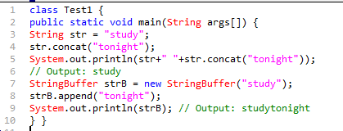

Example showing difference between String and StringBuffer
Reason:
Output is such because String objects are immutable objects. Hence, if we concatenate on the same String object, it won't be altered(Output: study). But StringBuffer creates mutable objects. Hence, it can be altered(Output: studytonight)

Slide 14
Important methods of StringBuffer class
The following methods are some most commonly used methods of StringBuffer class.
append()
This method will concatenate on the string representation of any type of data to the end of the invoking StringBuffer object. append() method has several overloaded forms.
StringBuffer append(String str)
StringBuffer append(int n)
StringBuffer append(Object obj)
The string representation of each parameter is appended to StringBuffer object.
StringBuffer str = new StringBuffer("test");
str.append(123);
System.out.println(str);
Output : test123

Slide 15
insert()
This method inserts one string into another. Here are few forms of insert() method.
StringBuffer insert(int index, String str)
StringBuffer insert(int index, int num)
StringBuffer insert(int index, Object obj)
Here the first parameter gives the index at which position the string will be inserted and string representation of second parameter is inserted into StringBuffer object.
StringBuffer str = new StringBuffer("test");
str.insert(4, 123);
System.out.println(str);
Output : test123

Slide 16
reverse()
This method reverses the characters within a StringBuffer object.
StringBuffer str = new StringBuffer("Hello");
str.reverse();
System.out.println(str); Output : olleH
replace()
This method replaces the string from specified start index to the end index.
StringBuffer str = new StringBuffer("Hello World");
str.replace( 6, 11, "java");
System.out.println(str); Output : Hello java
capacity()
This method returns the current capacity of StringBuffer object.
StringBuffer str = new StringBuffer();
System.out.println( str.capacity() ); Output : 16
Note: Empty constructor reserves space for 16 characters. Therefore the output is 16.

Slide 17
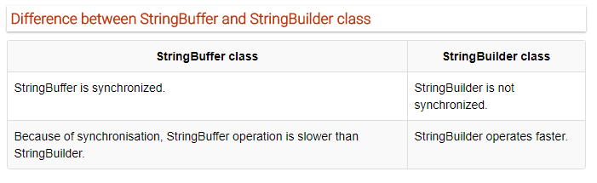
StringBuilder class
StringBuilder is identical to StringBuffer except for one important difference that it is not synchronized, which means it is not thread safe. Its because StringBuilder methods are not synchronised.
StringBuilder Constructors
StringBuilder ( ), creates an empty StringBuilder and reserves room for 16 characters.
StringBuilder ( int size ), create an empty string and takes an integer argument to set capacity of the buffer.
StringBuilder ( String str ), create a StringBuilder object and initialize it with string str.

Slide 18
Example of StringBuilder
class Test {
public static void main(String args[]) {
StringBuilder str = new StringBuilder("study");
str.append( "tonight" );
System.out.println(str);
str.replace( 6, 13, "today");
System.out.println(str);
str.reverse();
System.out.println(str);
str.replace( 6, 13, "today"); } }
Output :
studytonight studyttoday yadottyduts

